Slide 1
St Charles Heart and Soul
Presentation for
St Charles City Council
August 2020

Slide 2
“When a community takes the time to get to know itself, it gains a sense of identity and purpose that informs decisions about its future.” Lyman Orton, Founder and chairman of Orton Family Foundation
Notes:
Purpose of this PowerPoint presentation….
Share findings of the Heart and Soul Project
Overview of project’s history
Process used to collect and analyze what matters to residents
Results of survey/
Value Statements for St Charles
What’s next

Slide 3
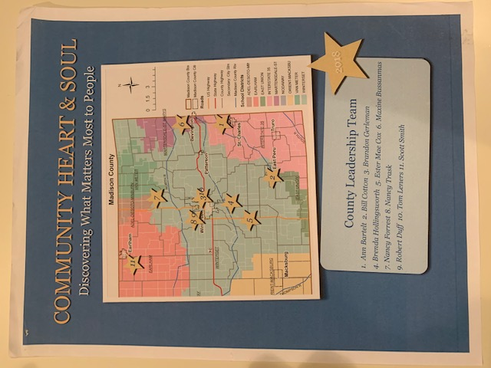
In the Beginning…
Madison County
Heart & Soul Leadership Team
Discovering What Matters Most
To People
Notes:
Madison Co is unique in the sense that there is a distinct county identity…Nationally. Madison Co is recognized for the covered bridges
In recent years, discussions focused on what will happen in the future as the county grows…Recognizing that change is inevitable, a task force was formed to determine what matters most –what needs to change and what need to stay the say
Partnership between local county government and residents to determine "what matters most” to the community
2017 citizens unite to discover the “Heart and Soul of Madison County”
Representatives recruited from all over Madison county were recruited in recognition of the seven communities within Madison County
This group soon came to realize that the county was made up of distinct communities –and so community teams were established

Slide 4
August 2018: St Charles Team Formed
Dawn Vetter, Chair
Ann Bartelt, Facilitator
Ester Mae Cox, Facilitator
Greg Van Wyngarden
Mary Seibert
Jon Von Felt
Becky Knight
Kristy Daniels
Kyla Findley
Tom Blomme
Dean Bartelt
Chris Benedict
Sharon Dentlinger
Susie McDonald
Kim Downs
Jessica Stark
Kyle Stark
Amanda Croxton
Brian Croxton
Rick Fitch
Dennis Peck
Gary Vetter

Slide 5
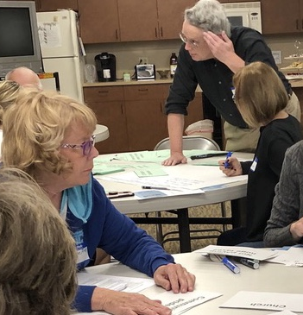
Team met monthly ……
Discussed how we should define our community
Explored who is in our community
Established a process and protocol to collect qualitative data—stories from real people
Notes:
Discussed how we should define our community
Explored who is in our community
Established a process and protocol to collect qualitative data—stories from real people

Slide 6
Adopted Heart and Soul Principles
Involve everyone—All voices matter
Focus on What Matters
Play the Long Game
Notes:
Connect with, listen to and embrace everyone who lives, works, learns or plays in St Charles Community – 50240 area code
Reach out to the underrepresented and hard to reach voices
Identify things/characteristics that distinguish St Charles and make it a good place to live
Lead decision-makers in recognizing “homegrown ideas” that the community members will support
Build ownership for and commitment to see results

Slide 7
Timeline
Phase 1
Lay Groundwork
Develop awareness
Phase 2
Identify demographics
Collect surveys
Phase 3
Analyze data
Identify themes
Create value statements

Slide 8
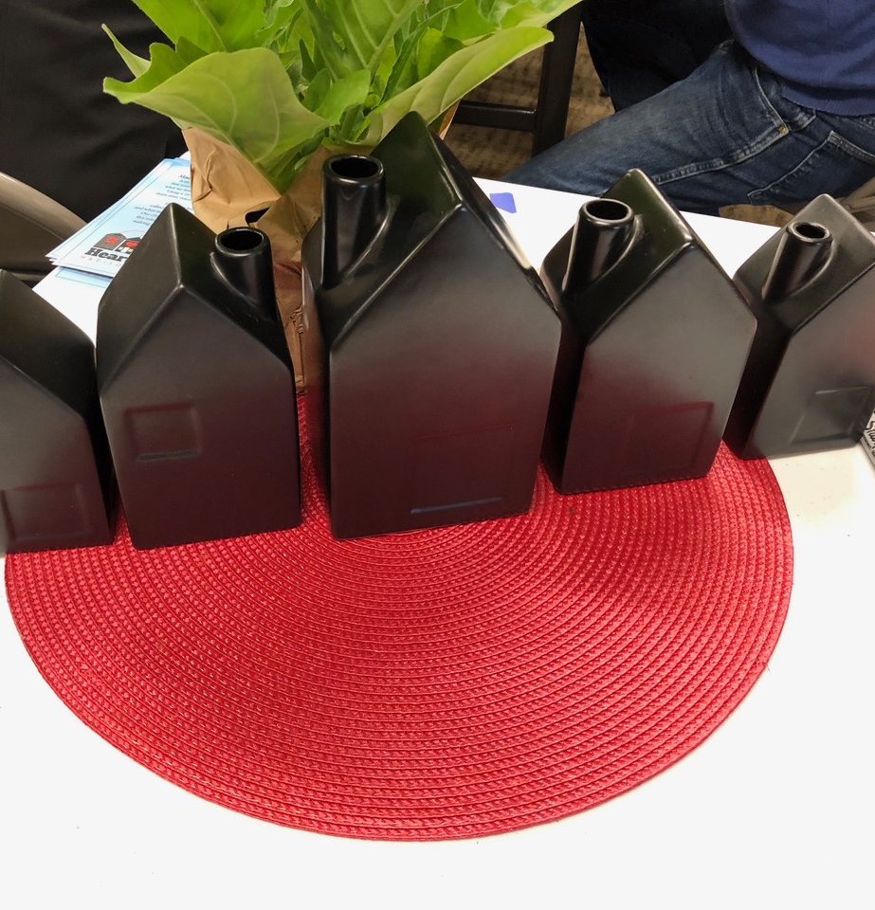
Lay the groundwork
Shared with Council, civic groups and organizations, attended neighborhood gatherings
Provided information at Old Settlers
Passed out candy canes with informational card at Community Christmas celebration
Posted information online at website and Facebook sites
Put informational flyers around town

Slide 9
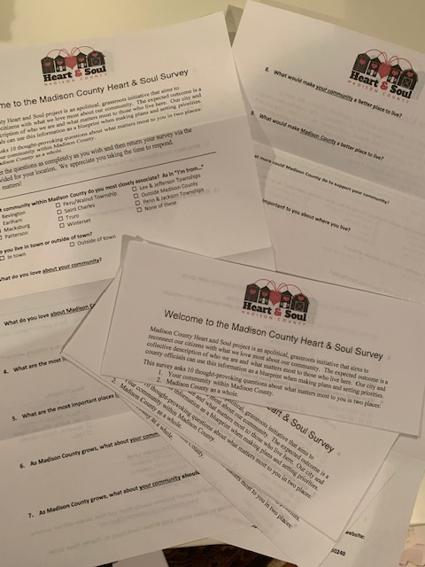
Collected surveys, listened to all voices…
Surveys collected online at MadisonCountyHeartandsoul.org
Paper copies and drop boxes placed around town
Recruited respondents at neighborhood parties
Conducted interviews
Attended school registrations
Recruited students to fill out survey
Add survey photo

Slide 10
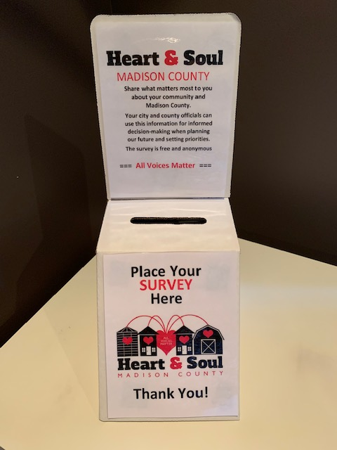
Voices were heard!
What do you love about St Charles?
What are the most important places in St Charles?
As St Charles grows, what should stay the same?
As our county grows, what about St Charles should change?
What more could Madison County do to support our community?

Slide 11
Identified St Charles Demographics
Total population of 50240: 2875
In St Charles: 625
Outside of town: 2250
Surveys collected:
216

Slide 12
Gender Distribution

Slide 13
Age Distribution

Slide 14
Annual Household Income

Slide 15
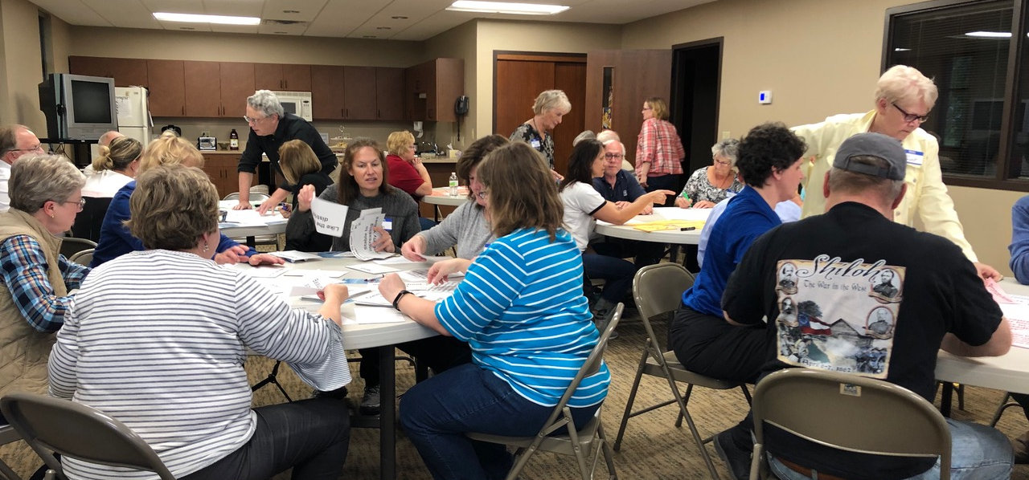
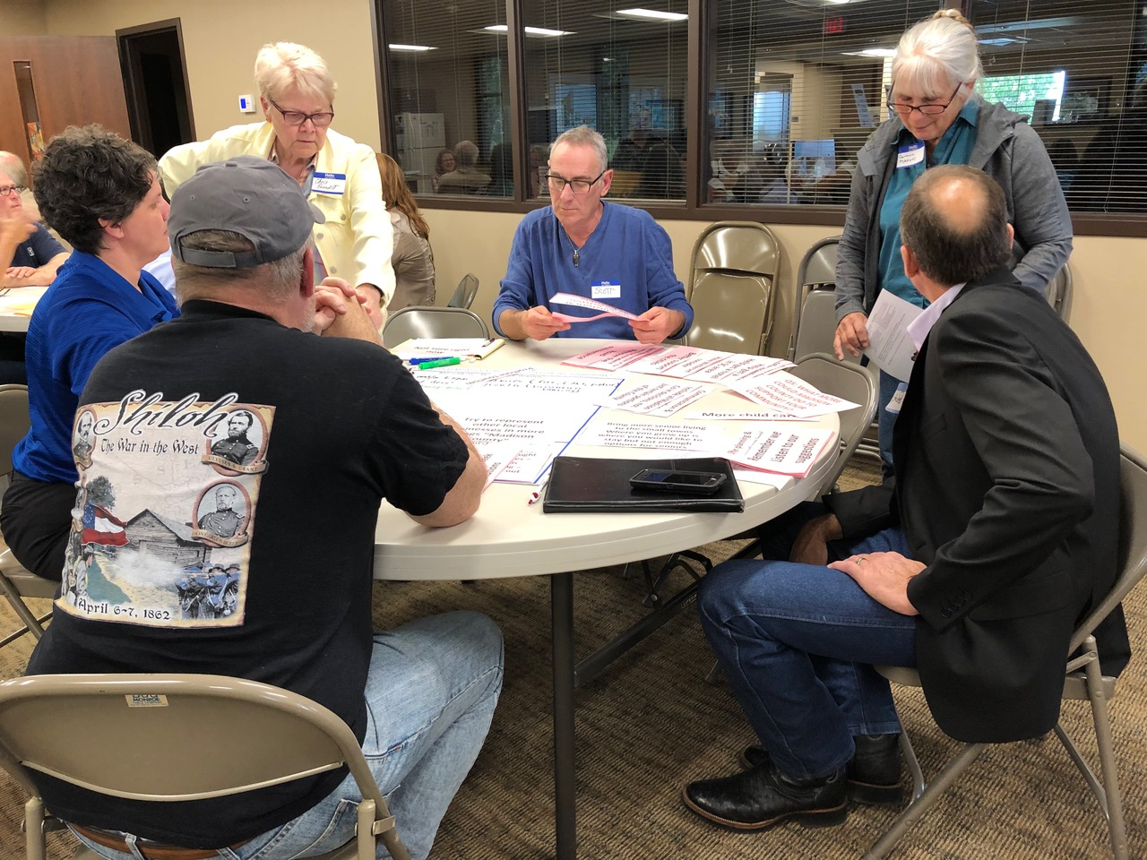
Community Meeting
May 22, 2019
Stimulating conversations…
values, issues and concerns,
hopes and goals

Slide 16
Data rich….
Survey responses coded into data bits
Themes created
Community members discussed “what matters”

Slide 17
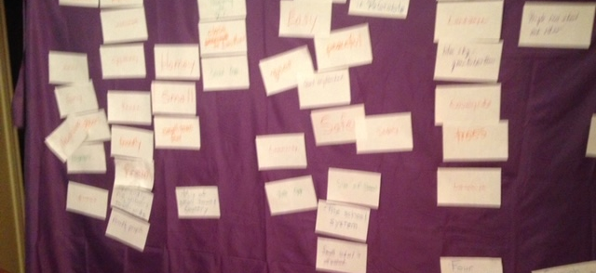
St Charles Team created Value Statements
Notes:
Talk about process
Each team member “vetted” statements with at least two other community members
Planned for a Community Summit for March 27

Slide 18
St Charles Community
Heart and Soul Summit
planned for March 23. . .
and then
COVID-19
Notes:
The efforts to share with SC community was put on hold to the Covid 19 Pandemic. Work with the project continued

Slide 19
Meanwhile…
Survey data from all of Madison County – 1037 respondents -- is analyzed with the help of ThriVinci
County leadership team articulates countywide value statements
Decision made to share findings with leaders and decision makers
Notes:
Thrivinci
Hired to assist
Funded by Co Supervisors
GMCCF
Lend unbiased reliability and accountability to analysis
Trained volunteers coded responses into categories
Report quantified qualitative data
Share page themes by county and community
Potenntial actions
Using data from the ThriVinci report and analyses work done by leadership teams, a representative team of volunteers crafted a set of statements that capture the themes and goals expressed in the data. In total, these statements express the shared vision of what matters most…

Slide 20
St Charles Heart and Soul Statements

Slide 21
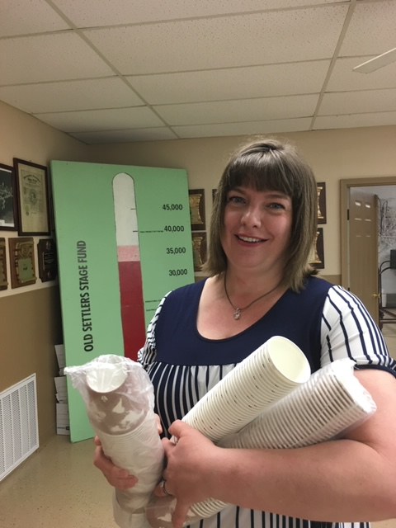
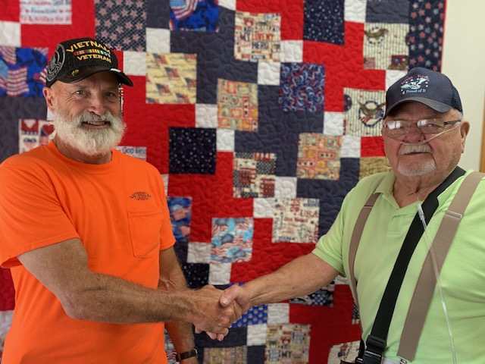
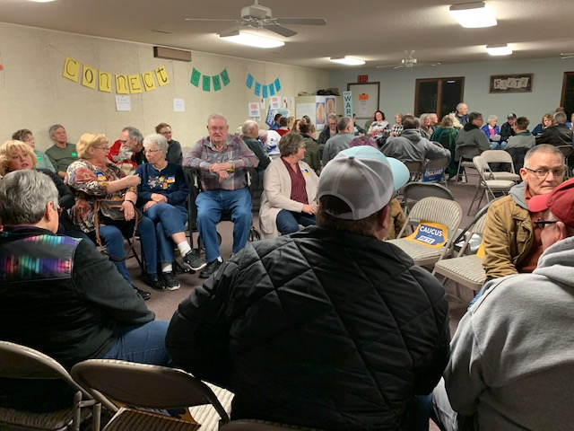
Small town feel…

Slide 22
Theme: Small Town
We value our small quiet rural community which provides a safe, neighborly, family friendly lifestyle.

Slide 23
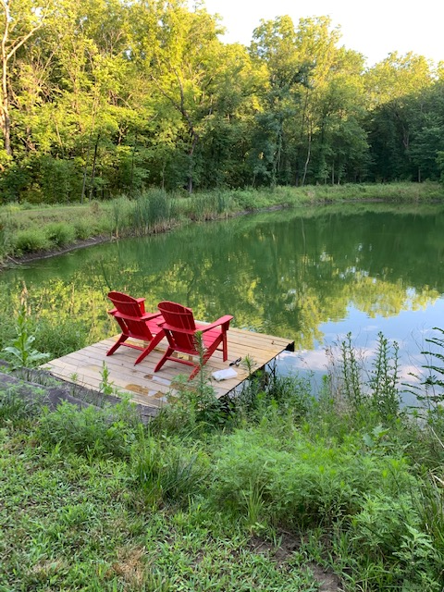
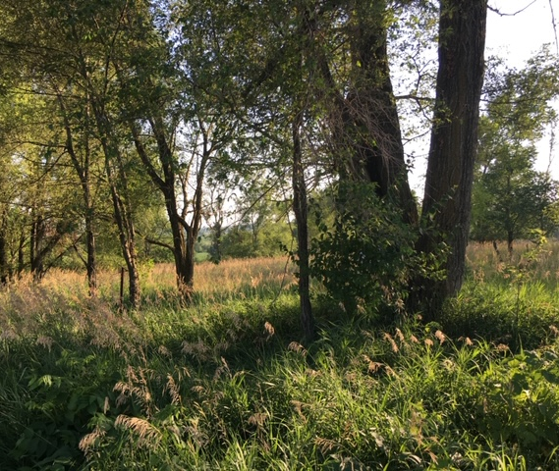
Natural Beauty

Slide 24
Theme: Natural Beauty
We embrace our scenic countryside and its natural beauty - open spaces, farm land, rolling hills, timber land, vibrant skies – which all contribute to our peaceful and relaxing environment.

Slide 25
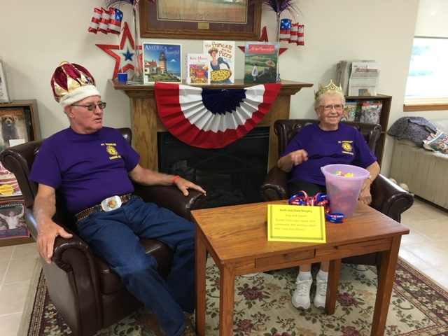
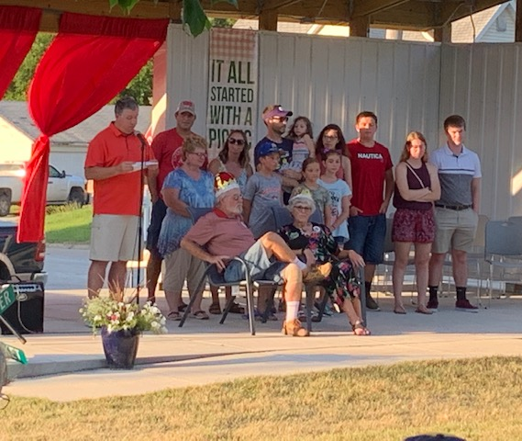
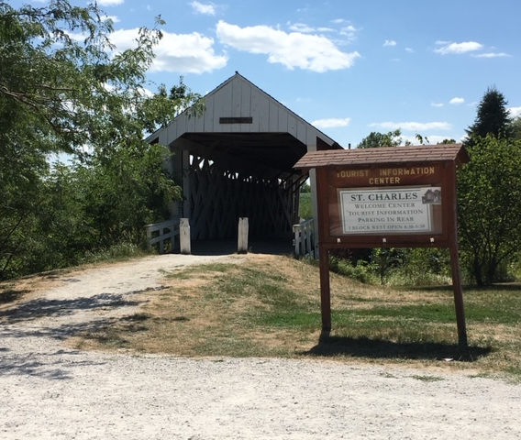
Heritage and Traditions

Slide 26
Theme: Heritage and Traditions
We celebrate our heritage and traditions through festivals and celebrations, which connect our community and honor our values as we grow.

Slide 27
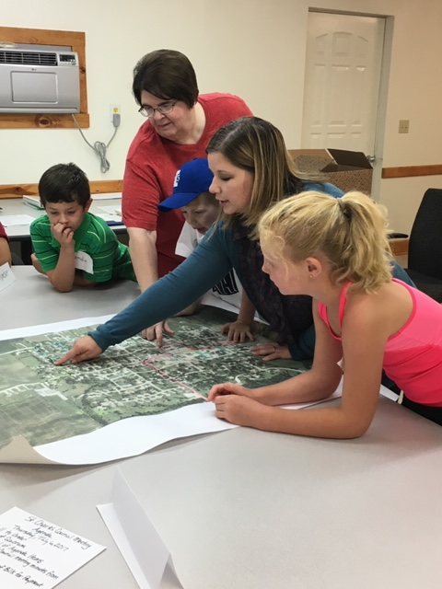
Community Connections

Slide 28
Theme: Community Connections
We appreciate and support our local government, businesses, churches, civic services and community organizations, which cooperate, collaborate, and coordinate their efforts toward our community’s well-being.

Slide 29
Next Steps
Celebrate!!!!
Translate our common values onto actions
Build toward a future that honors “what matters” to residents of St Charles

